Slide 1

NETWORK PROJECT of a bank
Computer Networking

Slide 2
ABOUT ME
NAME: Robiul Islam
STUDENT ID: 193-15-2994
SECTION: Pc-A

Slide 3

Purpose
This is a network of a bank which is will be friendly user interface and easy to update .
Notes:
Notes to presenter:
What is your purpose for sharing this reflection?
Is it at the end of a unit or project?
Are you sharing this reflection, at the attainment of a learning goal you set for yourself?
Is it at the end of a course?
State your purpose for the reflection or even the purpose of the learning experience or learning goal. Be clear and be specific in stating your purpose.

Slide 4
INTRODUCTION TO MY NETWORK
Here I am trying to build a bank network system and I hope it will be friendly user interface and easy to update .In this networking system are used by all banking user can use by shared their data very easily.
So that every user to take about network structure & security of banking system instantly anywhere .
Here I use an ip 192.0.0.0 and we completed 10 network ,it cost almost 300 host so it is
1st network take 101 host
2nd network take 50 host
3rd network take 35 host
4th network take 30 host
5th network take 25 host

Slide 5
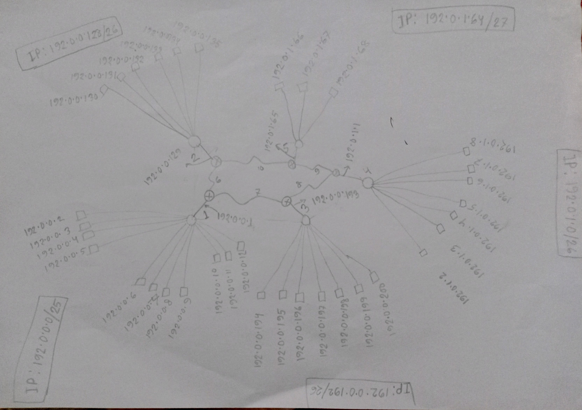

What was your process?
Notes:
Notes to presenter:
What did you think at first?
What obstacles did you encounter along the way?
How did you overcome those obstacles?
What images can you add to support your process?
This SmartArt allows you add images and text to help outline your process. If a picture is worth a thousand words, then pictures and words should help you communicate this reflection on learning perfectly! You can always click on Insert>SmartArt to change this graphic or select the graphic and click on the Design contextual menu to change the colors.
Feel free to use more than one slide to reflect upon your process. It also helps to add some video of your process.

Slide 6

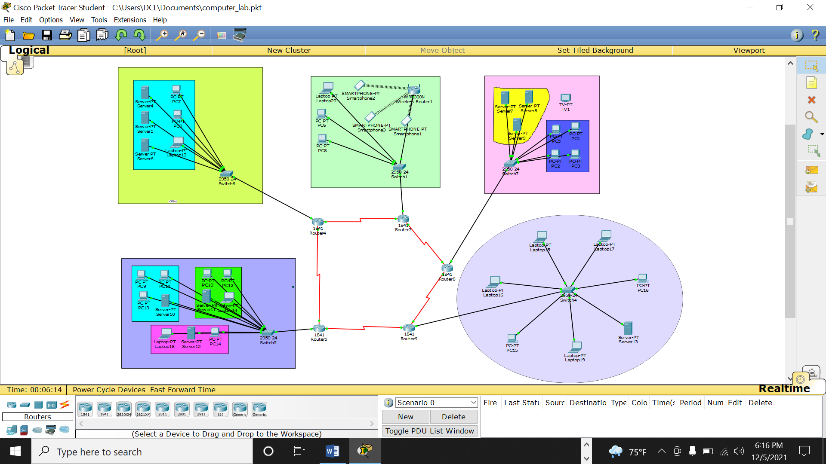
NEW THINGS I’VE LEARNED WORKING?
Wireless configuration.
Adding a server to the network.
Adding wireless laptops and smartphones on the network.
Increase the complexity of the network to a more realistic tier.
Adding new components in the network such as wireless router and smartphones.
Notes:
Notes to presenter:
Description of what you learned in your own words on one side.
Include information about the topic
Details about the topic will also be helpful here.
Tell the story of your learning experience. Just like a story there should always be a beginning, middle and an end.
On the other side, you can add a graphic that provides evidence of what you learned.
Feel free to use more than one slide to reflect upon your process. It also helps to add some video of your process.

Slide 7
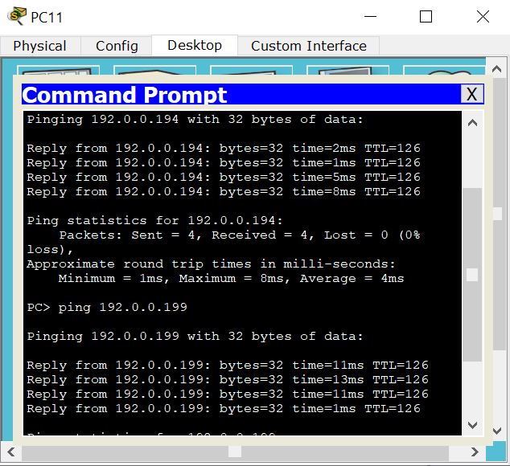
result
We can ping any device to any other device with this network i use her totally static routing for this bank t think it was a challenge for me to connect all network by static network so I tried and alhumdulillah its done

Slide 8

THANKYOU VERY MUCH SIR

